Slide 1
Capitol Area Council
Armadillo District
Friends of Scouting

Slide 2
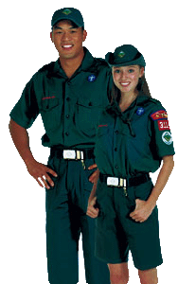
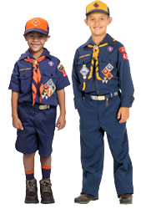

Why are you here today?
Notes:
What are you here today at this meeting?
There are probably a lot of differing reasons, but most it really boils down that you support Scouting
Why do you support Scouting?
There are probably a lot of answer to that too. You might think that Scouting is:
Opportunity to try new things
Service to Others
Leadership Development
Reinforces Family Ethical standards
It’s FUN!
What ever the reason, you DO support Scouting.
We are asking you to support Scouting Financially

Slide 3
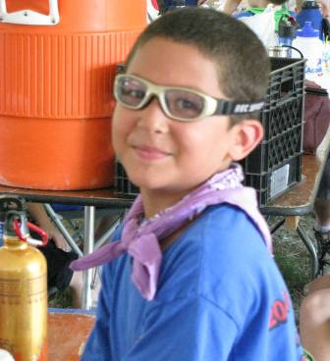
Friends of Scouting
  More than 22,000 scouts from throughout Central Texas benefit from this fund raising campaign
Notes:
3

Slide 4

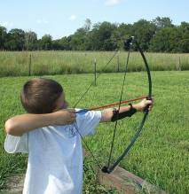

Friends of Scouting supports:
The ability for every young person regardless of financial condition, developmental disability, or location the opportunity to belong to Scouting;
Notes:
4

Slide 5
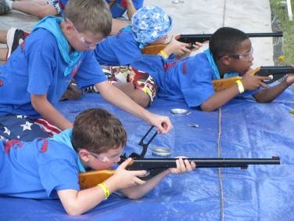
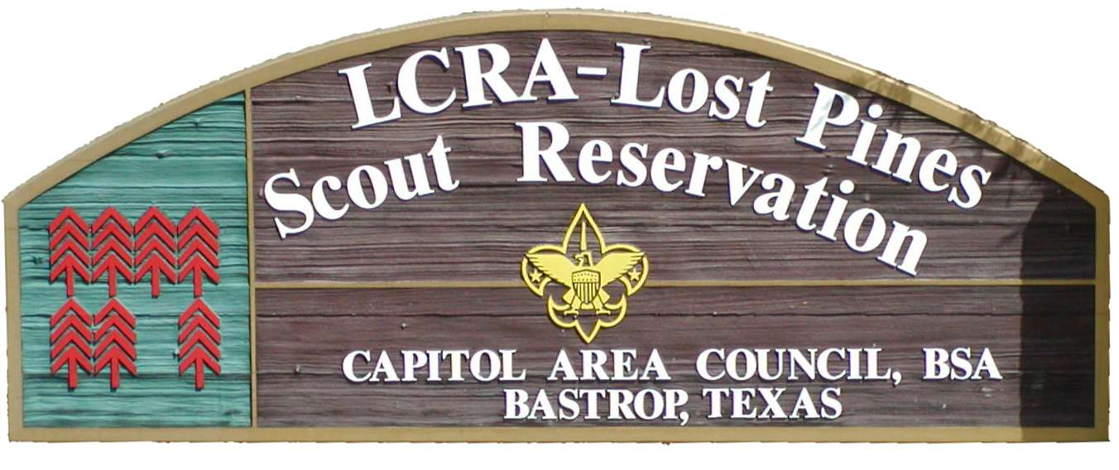
Friends of Scouting supports:
District and Council Camporees, Cub World events, and Boy Scout and Venturing activities;
Permanent Scout Camps
The professional staff
Volunteer training
Notes:
5

Slide 6
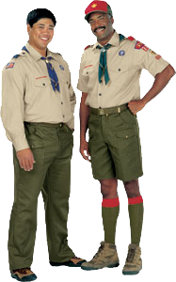
Friends of Scouting
  Scouters like you to make the Scouting a success
6
Notes:
6

Slide 7

Capitol Area Council Income
Most people do not realize that the local Council does not receive any portion of annual membership dues
26%
14%
13%
14%
Notes:
Local Council does not get any money from dues
26% from FOS
13% Camping revenue
14% Activity revenue
14% Popcorn
Rest from Trust, Investment, Scout Shop, Special events
7

Slide 8
Friends of Scouting Campaign Goals
8
  Overall Armadillo District FOS Goal - $185,000
    Family FOS Goal - $110,000
      This is the portion that come from Units
    How goals are set
      Monetary Goals - $250 per person
      Participation Goals - 75%
Notes:
8

Slide 9
How can I give?
You can give us a check today
  Made out to “BSA Capitol Area Council FoS”
You can give a pledge card today and pay later
You can make a contribution online
  https://www.bsacac.org/online_donation.php
You may be able to donate from work
  IBM and others companies allow direct donations to BSA
  Be sure to select the option that allows the company to notify BSA of your identity
9
Notes:
9

Slide 10
Donation Form
10
Notes:
10

Slide 11

Participation Recognition
Just a way to say Thank you!
A reminder to others of your Support for Scouting
11
Notes:
11

Slide 12
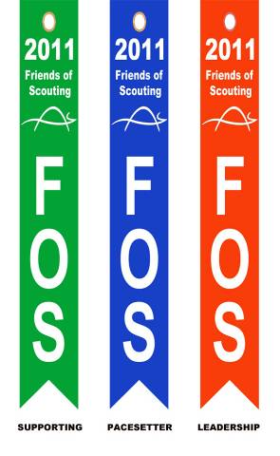
UNIT Recognition
Every Participating unit will receive at least one ribbon
  Green: Any donation on behalf of unit
  Blue: Achieved Unit Goal
  Red: Exceeded Unit Goal

Slide 13

Individual Recognition
Decal for all gifts
13
Notes:
13

Slide 14

$120 - Council Strip
14
Notes:
14

Slide 15
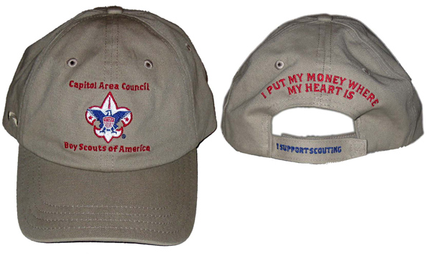
$240 - Boy Scout Hat
15
Decal
Patch
Hat
Notes:
15

Slide 16
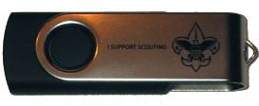
1$ a Day or $365 per year -
Flash Drive
Decal
Patch
Hat
Flash Drive (I support Scouting)
16
Notes:
16

Slide 17
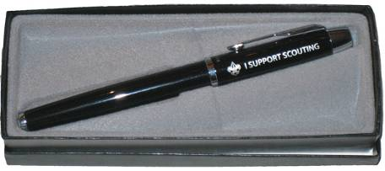
$500 and above - Scout Pen
17
Decal
Patch
Hat
Flash Drive (I support Scouting)
Scout Pen (I support Scouting)
Notes:
17

Slide 18
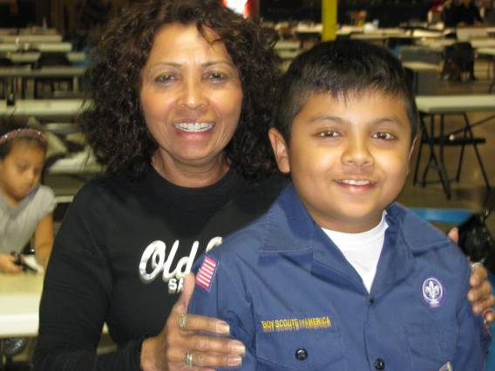
Thank you for supporting Scouting!
18
Notes:
18

